Slide 1
NNArm
INTERNATIONAL HELLENIC UNIVERSITY
POLYTECHNIC SCHOOL
DEPARTMENT OF COMPUTER, INFORMATICS AND TELECOMMUNICATIONS ENGINEERING
M.Sc. in ROBOTICS
P202 – MACHINE INTELLIGENCE
NNArm is a MATLAB/Simulink-based project for controlling a robotic arm using advanced neural network control techniques
Semester Project on Neural Networks of the Postgraduate Student
Kostelidis Iordanis

Slide 2
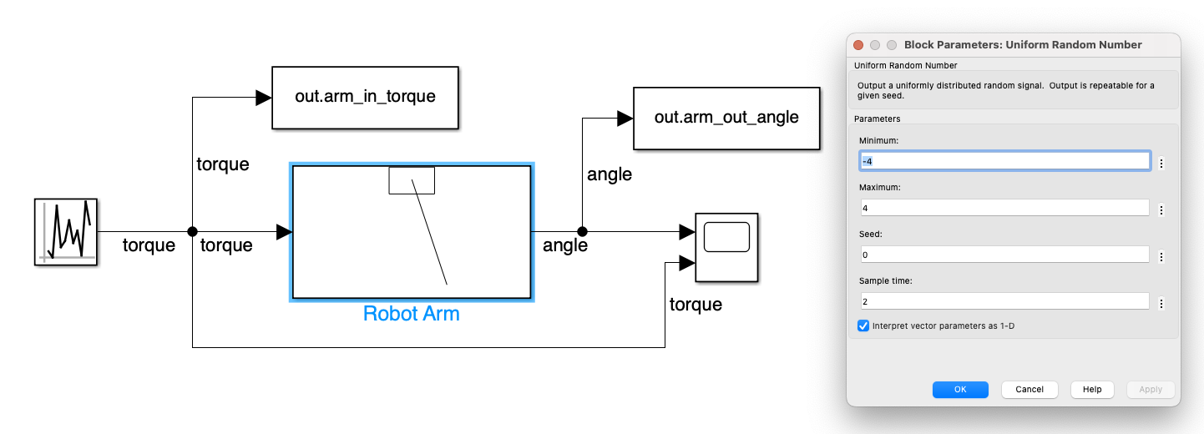

Slide 3
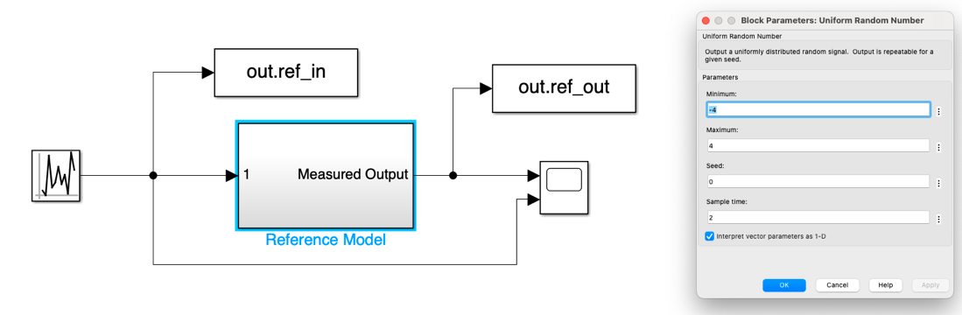

Slide 4
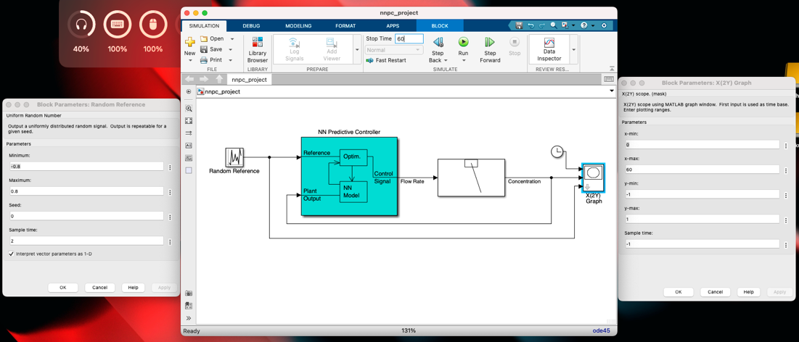

Slide 5
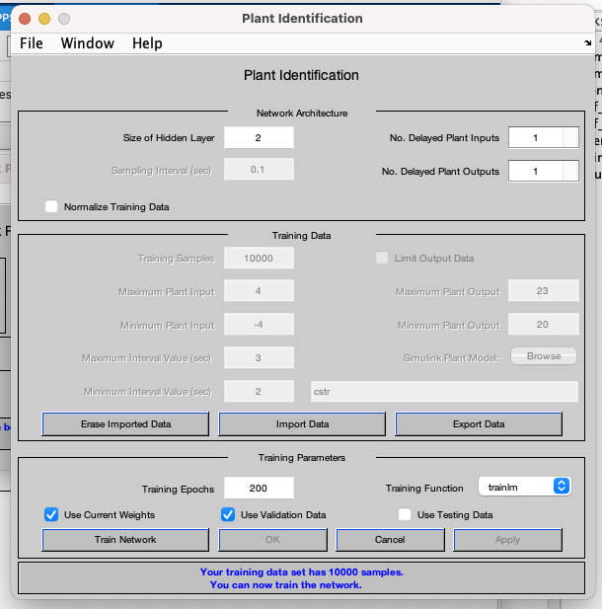

Slide 6
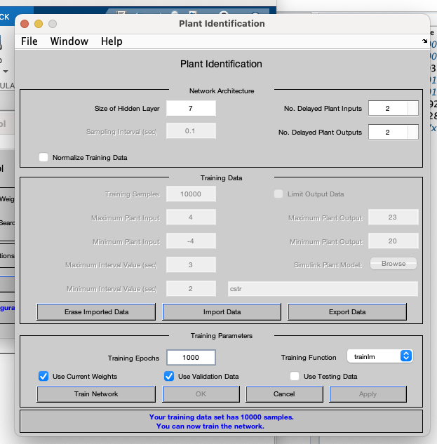

Slide 7
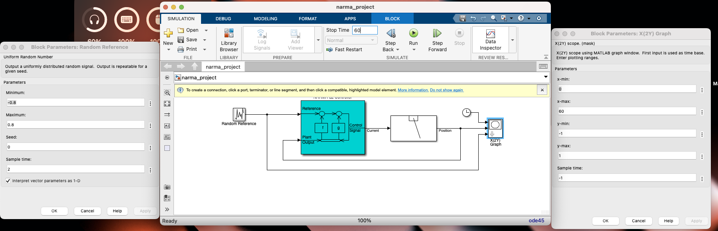

Slide 8
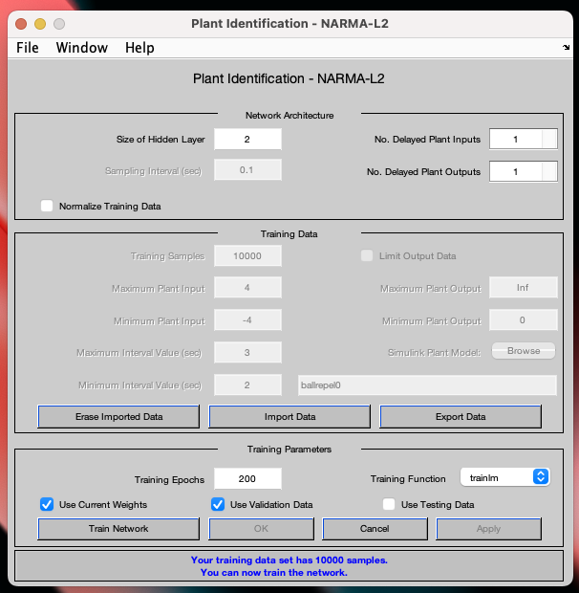

Slide 9
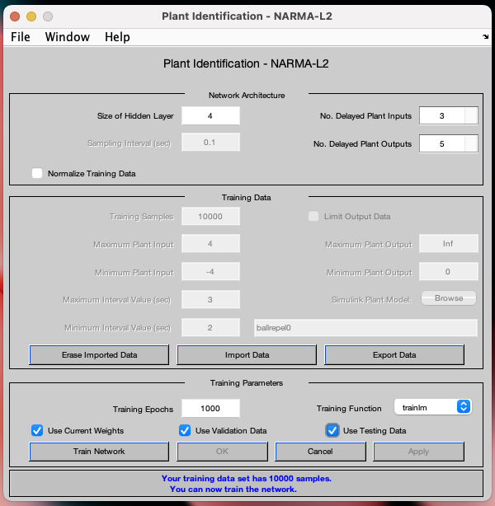

Slide 10
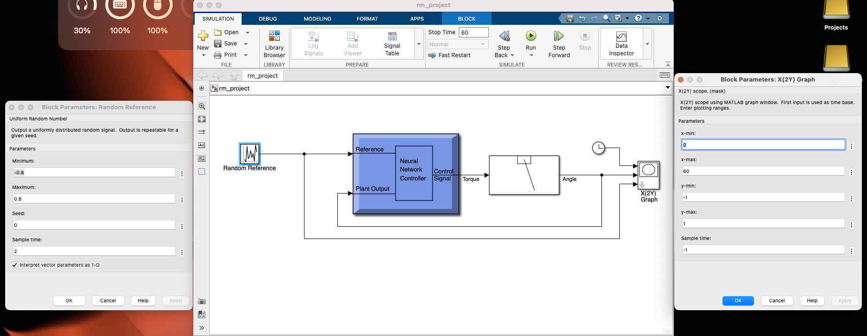

Slide 11
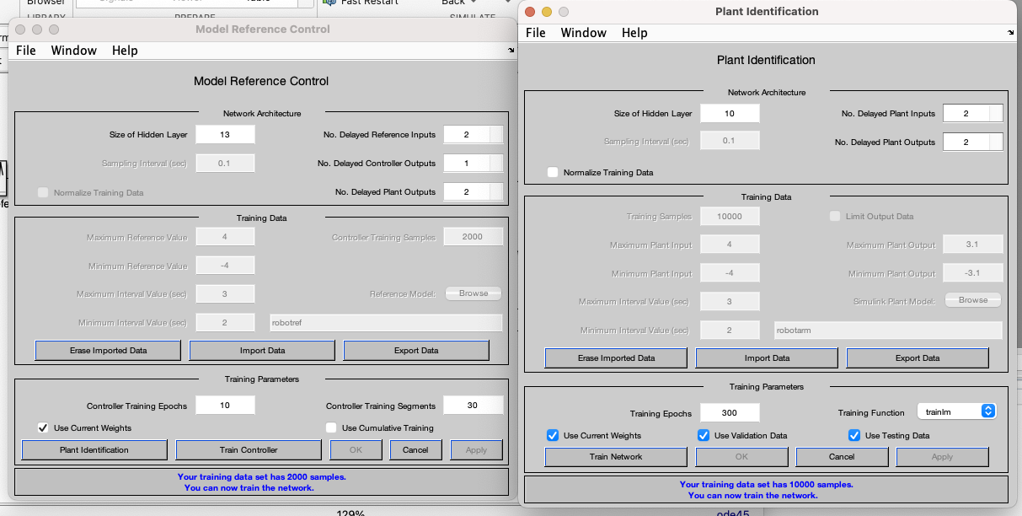

Slide 13
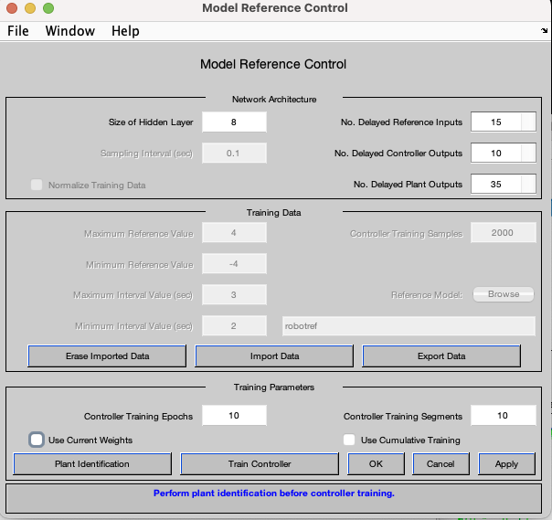
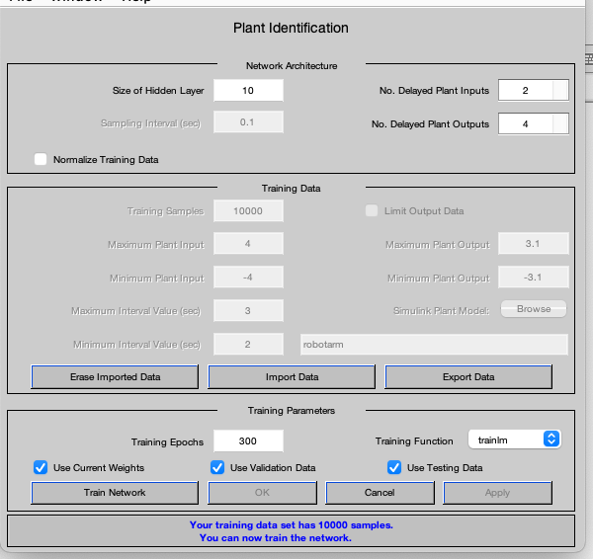

Slide 15
Neural Network Predictive Controller
Model Reference Controller
NARMA­L2 Neural Controller

